Slide 1


Slide 2
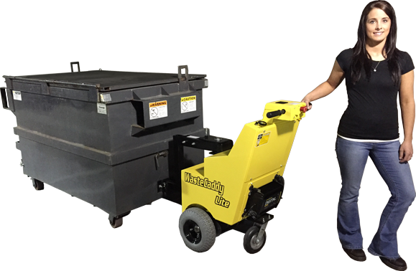
WasteCaddy Dumpster Mover

Slide 3
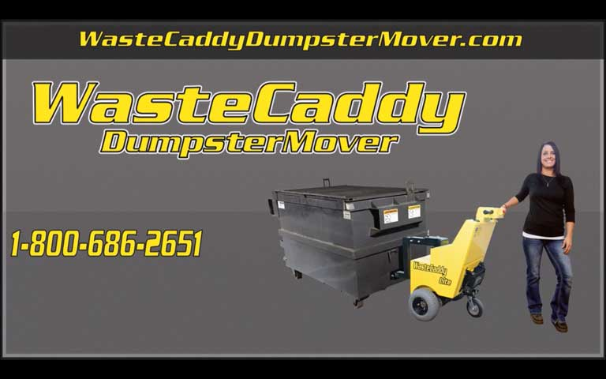
WasteCaddy Dumpster Mover
Right side should be still shot of 40 sec video with “play” arrow

Slide 4

Why Do We Need One?
Insurance Companies Recommend the
WasteCaddy as a
‘Best Practice’
The WasteCaddy provides improvement in:
Safety, Efficiency, Cost Control

Slide 5
Employee Safety
Insurance Company Data Shows
The #1 area for injury claims in multi-family properties
is the trash room
Highest incidence of back strain, slip/fall, pinch/crush injuries
Dumpsters with compacted trash are 3-4x heavier
Distance and incline magnify the risk exponentially
Wet surfaces, snow and ice create slip/fall hazards
Tractors, golf carts, ATVs are dangerous, and a big liability risk

Slide 6
Double Efficiency, ROI less than 12 months
Before
After
2 Maintenance Techs
2 Hours Effort (x2)
4 Days a Week
16 Hours
1 Maintenance Tech
2 Hours Effort
4 Days a Week
8 Hours
Annualized Savings of $5,616 based on $13.50/hour
This is a conservative hourly rate. Actual data is likely to be higher, which will shorten the ROI.

Slide 7
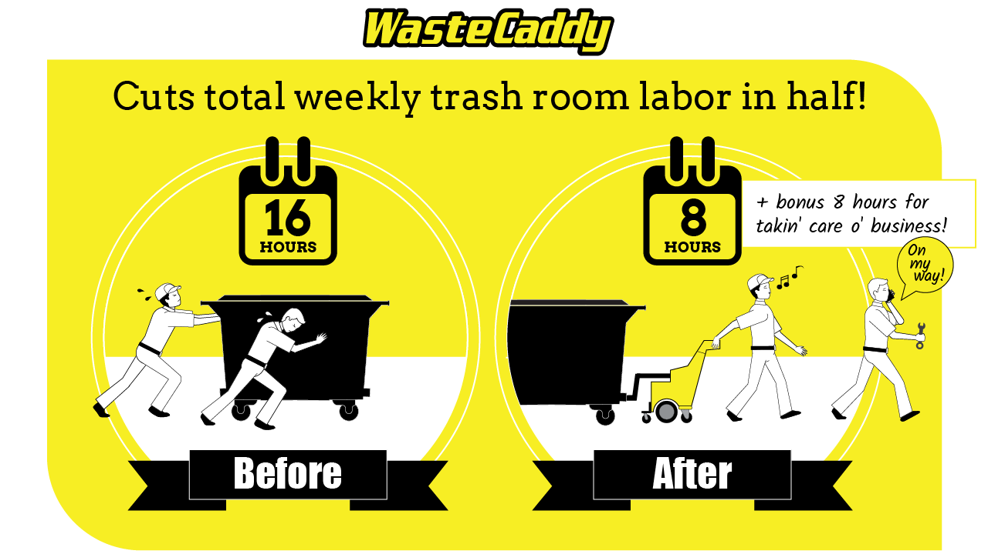

Slide 8
Cost Control
Workers Comp Claims Can Impact Our Fee Structure
1 In 5 Worker’s Comp Claims Will Result In A Lost Time Injury
The Average Cost of a Workers Comp Claim = $41,197*
3 Year Increase In Insurance Premiums Average = $94,793*
* Public Data collected between 2011 and 2015 from a large monoline worker’s compensation insurance company related
to their real estate management customers.

Slide 9
Why Are We Recommending WasteCaddy?
  Innovation –
    We are always looking for innovative ways to help associations reduce risk, improve safely and reduce cost. This product fits the bill.
  Efficiency –
    Employees of any age, strength or gender can move dumpsters safely,
    on their own.
  A “Best Practice” –
    Insurance companies and Risk Consultants have identified WasteCaddy as a tool proven to reduce injuries and generate a strong ROI.
  Cost Control –
  Reducing injuries and claims will help keep insurance premiums from escalating.

Slide 10
WasteCaddy – Built for Reliability
It’s Small –
It’s Maneuverable –
It’s Powerful –
Push and Pull –
Heavy Duty –
Standard Parts –
WCLite footprint is 28’’ x 36”. Control handle to dumpster attachment is 40”
Variable speed & 90 degree turning allow movement in tight spaces.
Able to move heavy loads (WCLite: 5000lbs, WC: 10000lbs, flat surface rating).
Pull the dumpster out to empty it, then Push it back into a tight compactor room.
Weighted for traction on inclines, wet and icy conditions.
Maintenance-free options and off-the-shelf replacement parts for maximum reliability

Slide 11
What’s Wrong with the Way We Do It Today?
Gators, ATVs, Golf Carts, Pallet Jacks
Maneuverability – connecting to the dumpster INSIDE the trash/compactor room reduces risk of push/pull/pinch/slip injuries. Having to move the dumpster out in order to hook up it defeats the purpose.
Modifying an ATV, golf cart or pallet-jack to move dumpsters can void manufacturer’s liability
Battery powered devices are cleaner and lower-maintenance than gas powered machines.
Pallet jacks have limitations related to traction… stability…storage and are prone to high-centering over bumps or uneven surfaces.

Slide 12
Thank You!

